Slide 1
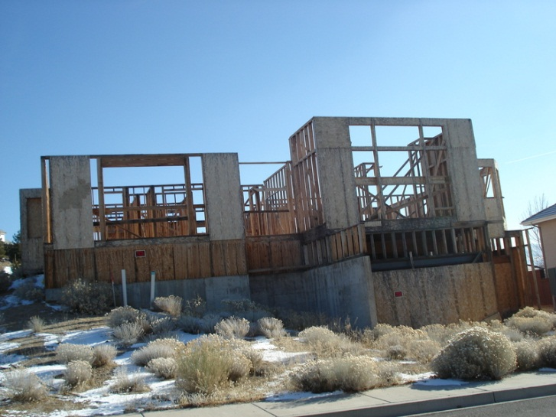
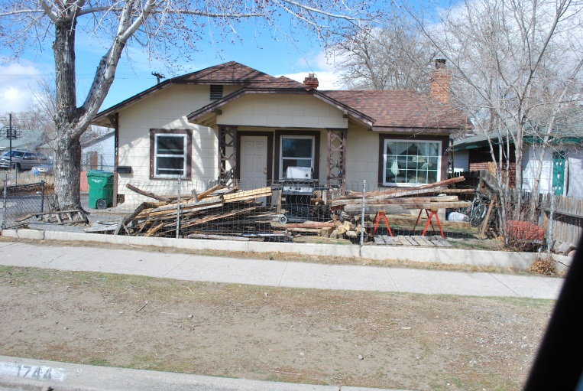
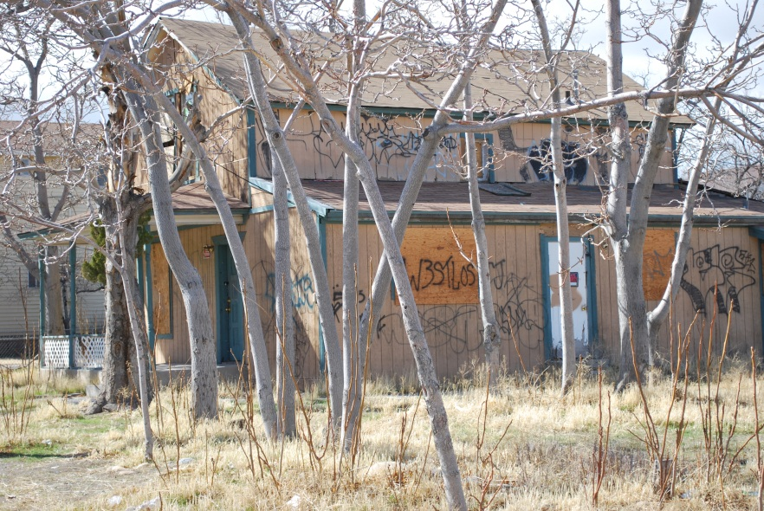
Sparks Police Department Community Response Unit Concept

Slide 2
Presentation Outline
Community Response Unit (CRU) functions
Organizational chart
Mission
Problem identification
Response and solutions
Measurable outcomes
Resources needed
Funding

Slide 3
Community Response Unit Functions
Police Department driven unit.
Improve quality of life issues city-wide.
Address graffiti, parking, and certain code enforcement violations to improve appearance of neighborhoods.
Reduce the fear of crime.
Measure results and report findings.

Slide 4
Community Response Unit
Police Lieutenant
(1)
Police Office Specialist
(1)
Police Sergeant
(1)
Police Officers
(5)
Police Assistant
(1)
Graffiti Officer
(2)
Graffiti Abatement
(2)
Notes:
This Team would fall within the Patrol Division under the direction of the Patrol Commander
Sets direction of the team
Lt. responsible for
the overall day to day operation of the unit
supervise sergeant
assist in the supervision of subordinate employees
Sets and attends community meetings
Sergeant responsible for
Direct supervision of the unit
Participates in unit activities
Attend community meetings
Police Officer Specialist
Clerical duties
Track vacant and foreclosed properties
Police Officers
Enforce ordinances that apply to zoning, parking and criminal activities
Promote Community Revitalization
Attend community meetings
Apply Broken Windows theory to communities
Police Assistant
Assist officers in field work, research, etc.
Enforce Parking violations
Graffiti Officers
Track, monitor, investigate and enforce graffiti violations
Work with Graffiti Abatement to ride city of Graffiti
Graffiti Abatement
Work with Public and Private property owners to rid City of graffiti
Assist Graffiti Officers tracking incidents of graffiti

Slide 5
CRU Mission
To improve the quality of life for residents, businesses and visitors within the city by addressing and responding to all aspects of graffiti; parking issues and neighborhood appearance.

Slide 6
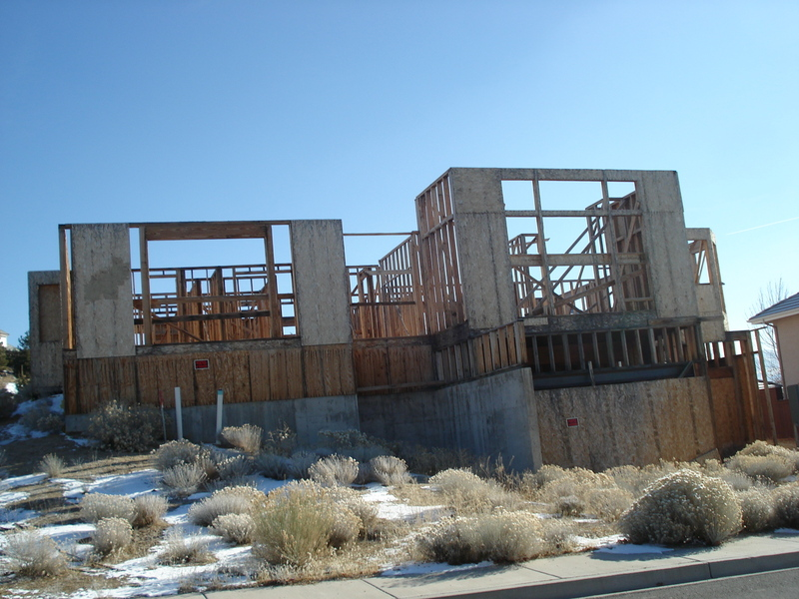
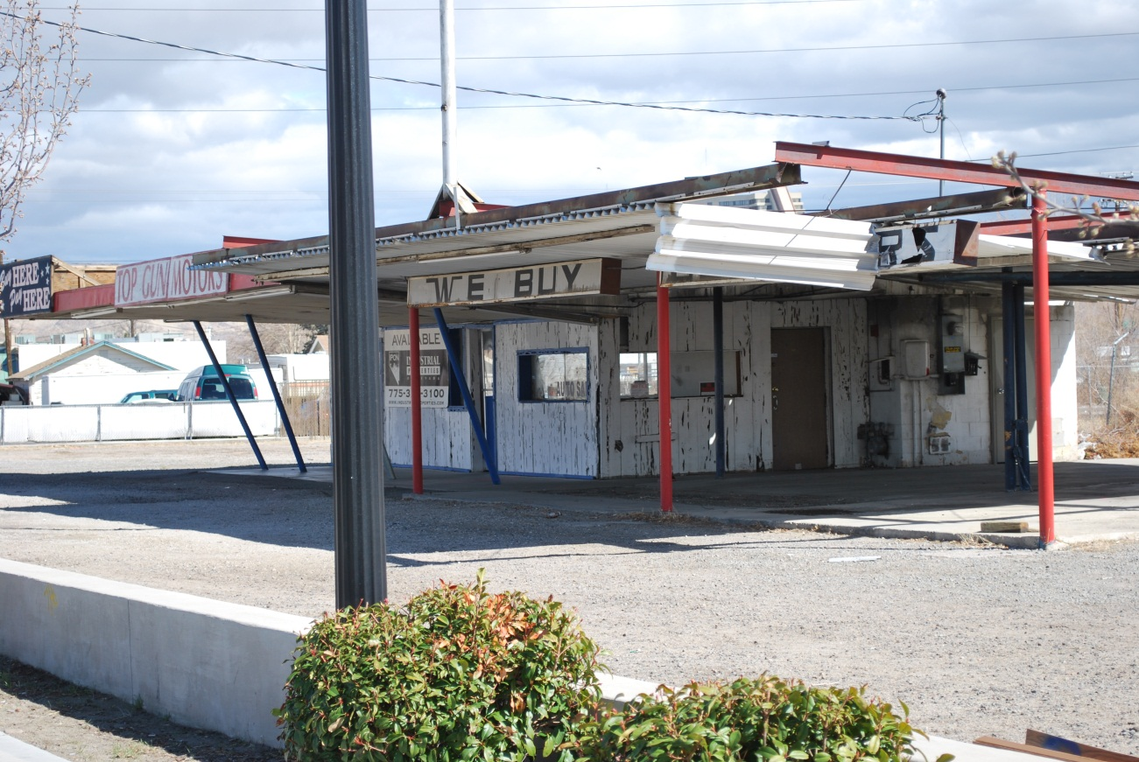
Problem – Vacant Homes
Fear of crime; property value decline and quality of life

Slide 7
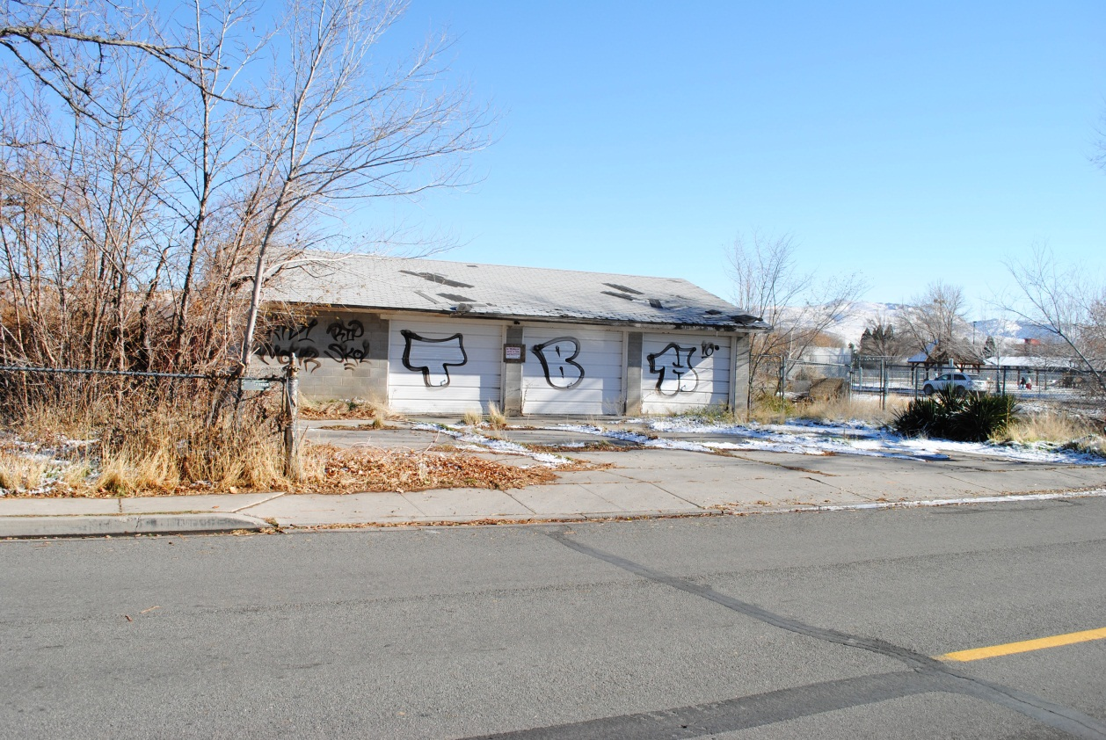
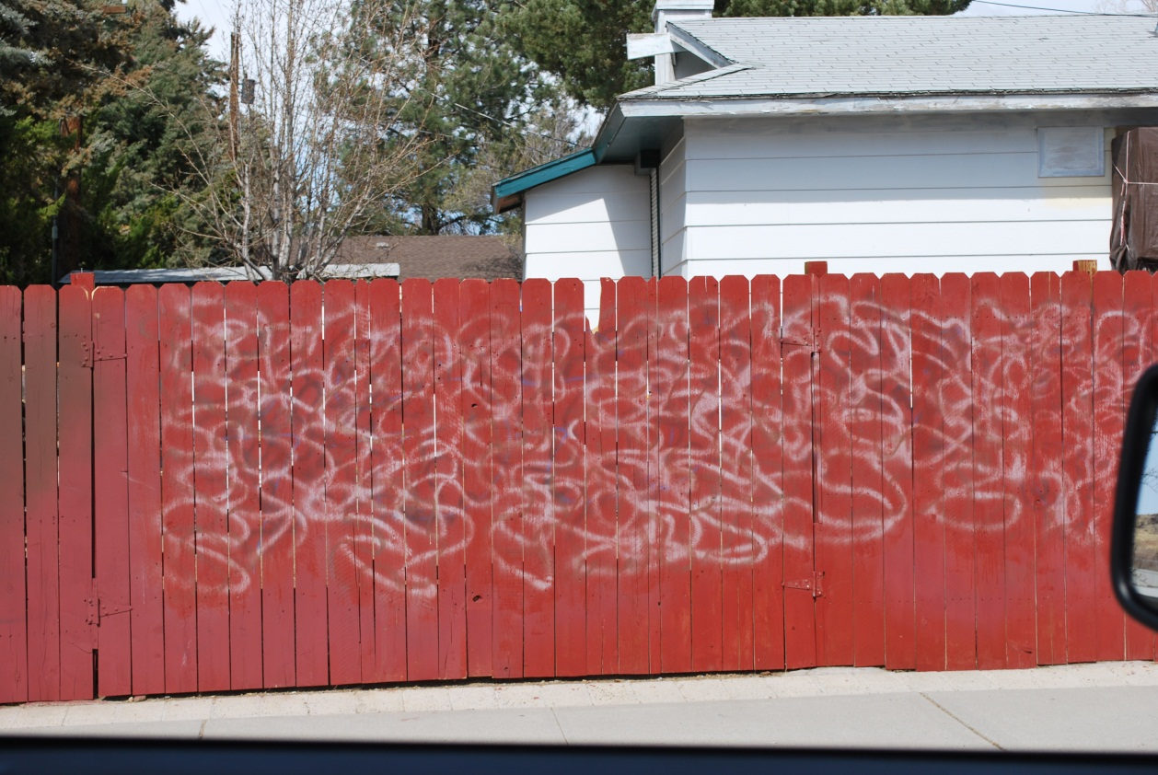
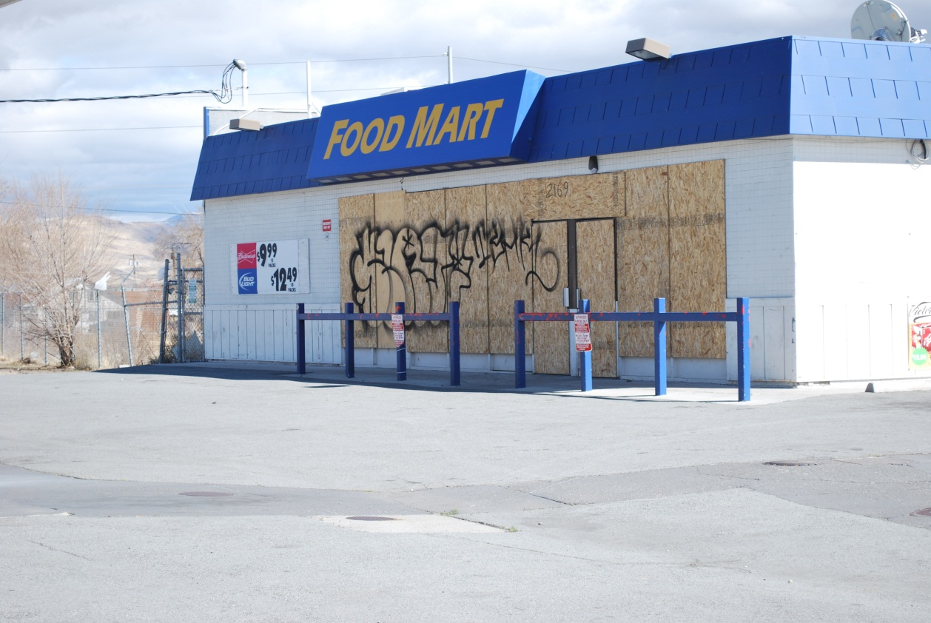
Problem - Graffiti
Fear of crime; property value decline and quality of life

Slide 8
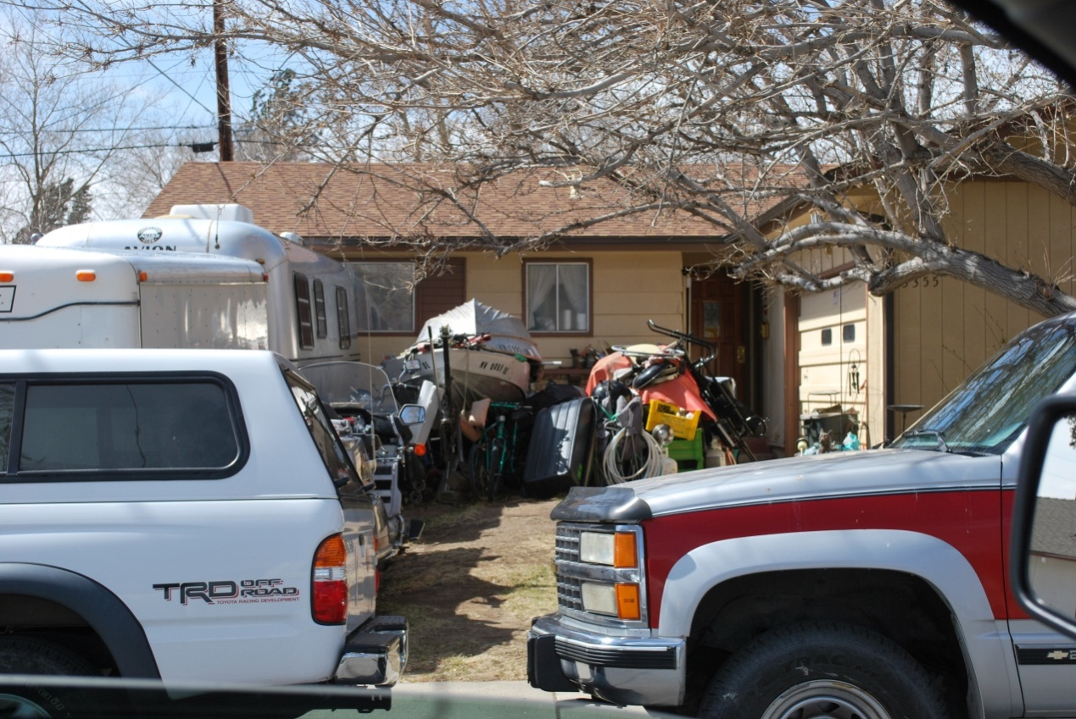
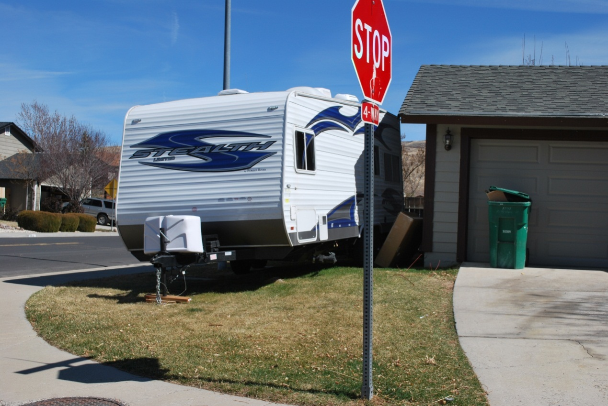
Problem – Neighborhood Appearance
Fear of crime; property value decline and quality of life

Slide 9
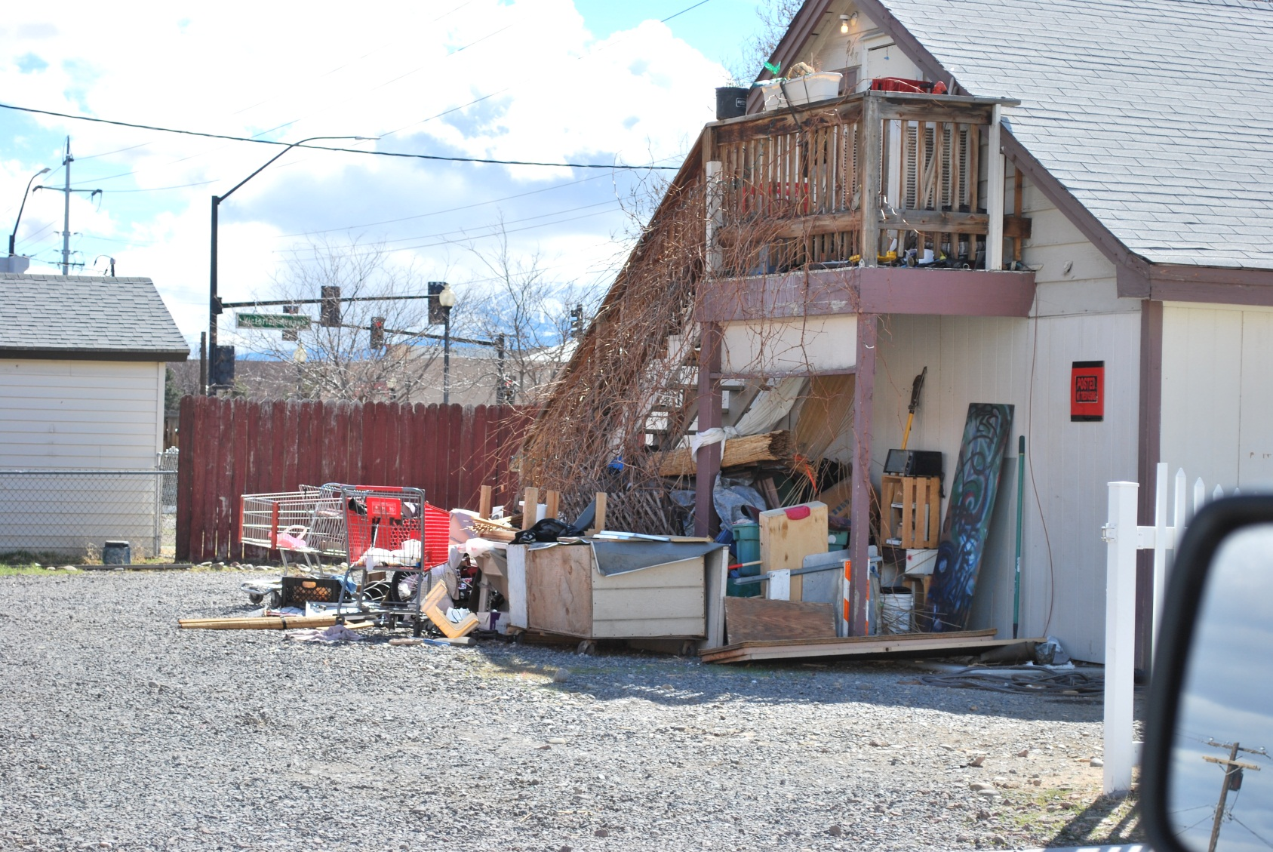
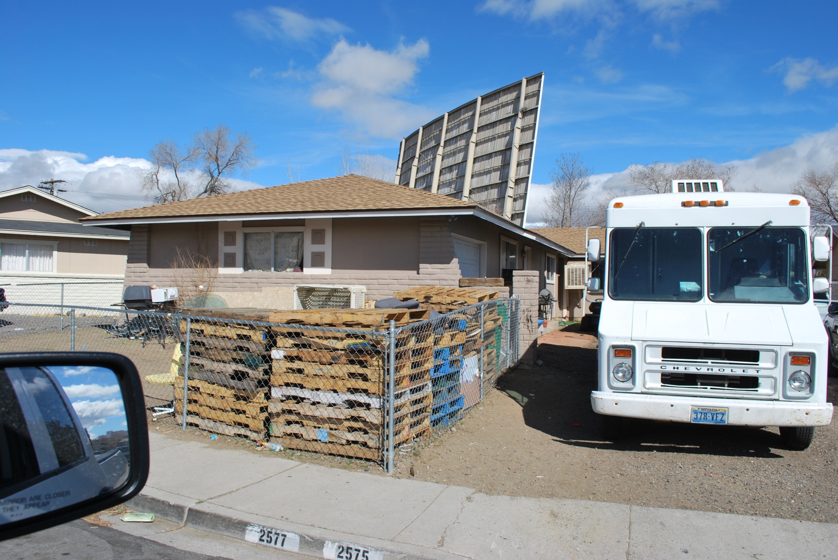
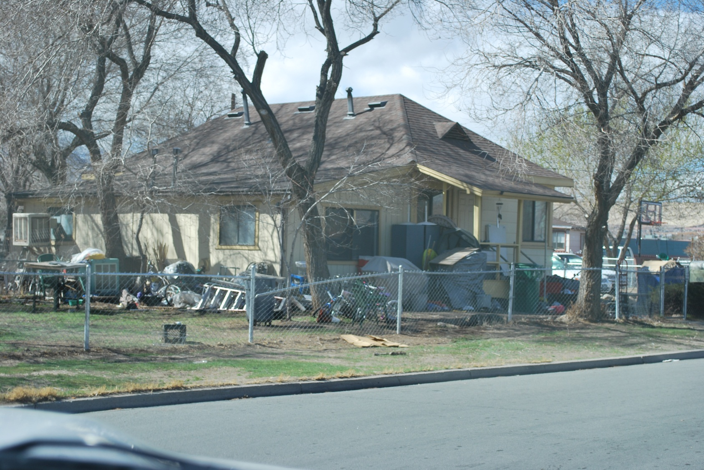
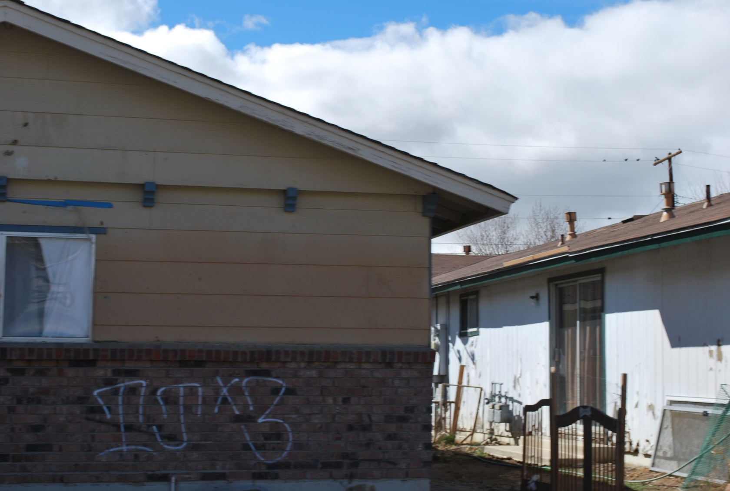
Other Pictures

Slide 10
Response and Solution
Develop a specialized unit within the P.D.
Revise applicable ordinances
Establish an advisory board
Create neighborhood partnerships

Slide 11
Graffiti Measureable Results
Education
# of school presentations
# of media stories
Intelligence
% of city-wide graffiti captured for analysis
# of intelligence briefings to department
Enforcement
# arrests adults/juvenile
# of cases assigned for investigation

Slide 12
Parking Enforcement Measureable Results
# of calls for service
# self-initiated contacts
# citations issued
# verbal warnings
# marked and tagged
# towed

Slide 13
Neighborhood Appearance Measurable Results
Before and after pictures
$ amount spent on maintenance
$ re-cooped through liens/assessments
# citations issued
# warnings issued
# calls for service
# self-initiated activity
# overall crime statistics
% fear of crime before/after

Slide 14
Steps Taken
Developed structure and concept of unit.
Applied for 5 police officer positions with the COPS Office under the COPS2012 grant.
Coordinated with Senator Reid’s Office for potential funding.

Slide 15
Existing Resources
Facility and Equipment
PD facility (computers, desks, etc.)
(1) Patrol marked vehicle
(1) Police assistant van
(1) G.R.I.P. vehicle and equipment
Personnel
(1) Graffiti abatement worker*
(1) Police assistant
* From Community Development

Slide 16
New Needs
 | Personnel Needed | Approx. Costs
(1) | Police Lieutenant | $ 138,055
(1) | Police Sergeant | $ 121,402
(5) | Community Response Officers | 425,935
(2) | Graffiti Officers | 170,374
(1) | Graffiti Abatement Specialist | 60,656
(1) | Police Office Specialist–Abatement* | 63,733
 | Total – Personnel New | $ 980,153
 | * Partially funded through P/T Community Development position
 | Equipment Needed | Approx. Costs
(9) | Officer Start-up Equipment | 100,000
(8) | Vehicles – Patrol | 440,000
 | Total -- Equipment | $ 540,000

Slide 17
Partial Funding Source to Consider: Raising the Property Tax Rate
Per NRS 362.140 the property tax rate is capped at $3.64 per $100 of assessed valuation
SB 507 (‘03 Legislature) added a total of 2 cents outside of the cap, which effectively raising the rate cap to $3.66 per $100 assessed value
The City of Sparks current property tax rate is $3.6163 per $100 of assessed value
This means that the City of Sparks total tax rate is $0.0437 (4.37 cents) under the maximum rate allowed of $3.66 per $100 of assessed value

Slide 18
Partial Funding Source to Consider: Raising the Property Tax Rate
The City Council has the authority to raise the property tax rate for the City of Sparks by $.0437 per $100 of assessed valuation
A separate ballot vote is not required
Each penny that increases the tax rate will generate approximately $189k of additional tax receipts for the General Fund after abatement is calculated
Increasing the property tax rate to the maximum of $3.66 per $100 of assessed value will generate approximately $825k of General Fund revenue

Slide 19
Closing
I suggest City Council supports and allocated funding that would create the Community Response Unit, providing the citizens a neighborhood of safety, security and pride.

